Slide 1
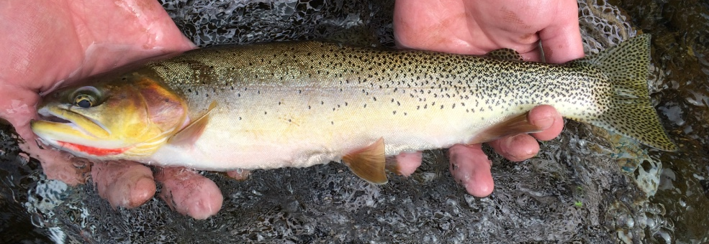
Headwater Stream Production and Fish Biomass
Zach Lessig

Slide 2

Why this study?
Headwater streams are sensitive ecosystems
Headwater streams are habitat for cold-water fish that may suffer as the climate warms.
Stream metabolism incorporates information about all aerobic organisms and habitats.

Slide 3
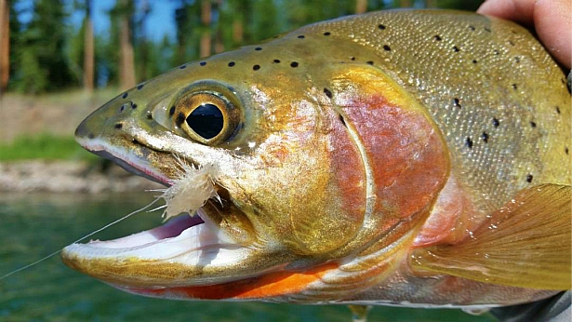
Why this study?
Goal: Understand what factors influence
gross primary productivity,
ecosystem respiration and
Cutthroat trout biomass in headwater streams
Objective: Identify what environmental variables best predict stream ER, GPP and trout biomass.
Originally These were supposed to be related to WSB however that did not work out.

Slide 4
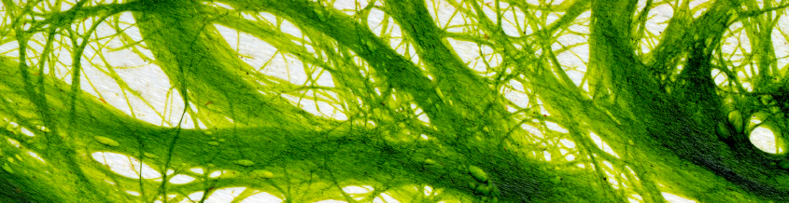
Some terms…
Gross Primary Production (GPP) – this is the phototrophic synthesis of organic compounds using light and CO₂ which produces O₂.
Ecosystem Respiration (ER) – this is the release of CO₂ through metabolism by autotrophic and heterotrophic organisms which consumes O₂.
Trout Biomass – this is the estimated mass of all trout per stream reach.

Slide 5
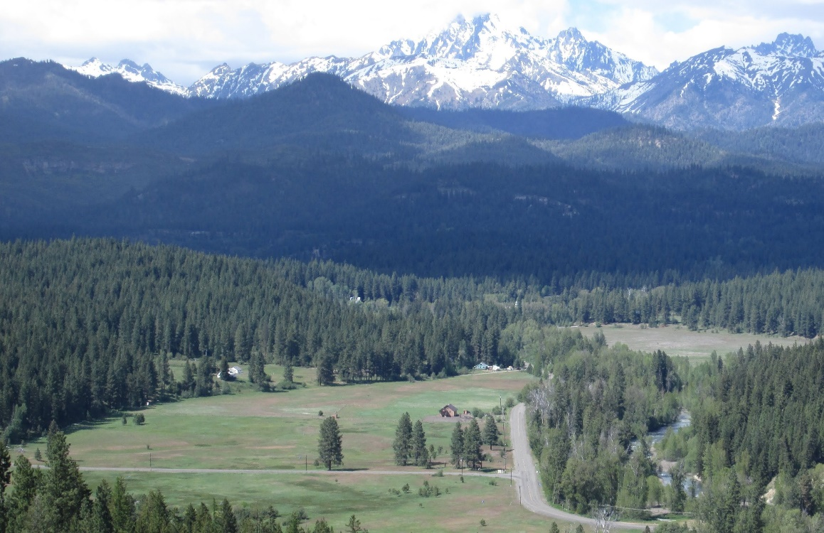
Study Design – 10 streams
Swauk
Teanaway
Taneum
Swauk
Iron
Blue
Hurley
Hovey
Miller
Jack
Standup
First
Frost
Sampled:
Summer ‘17
Fall ‘17
Summer ‘18
Teanaway

Slide 6
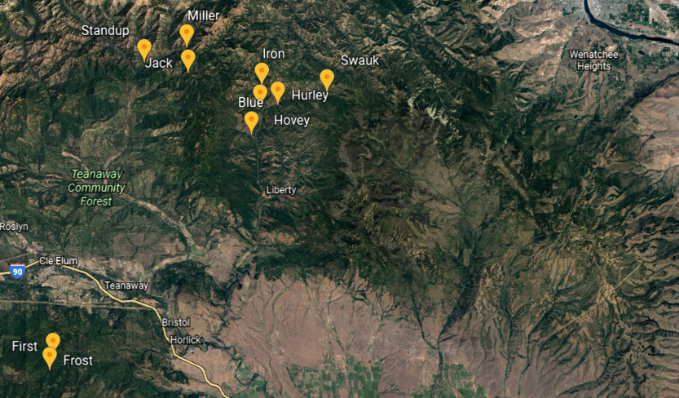

Slide 7

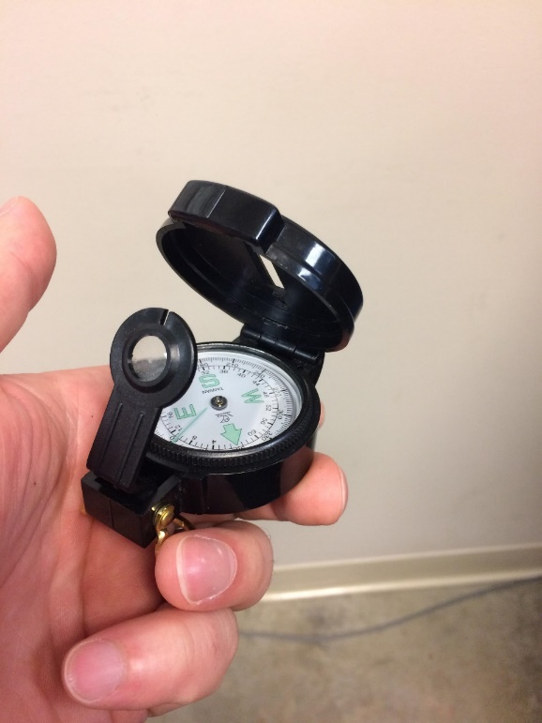
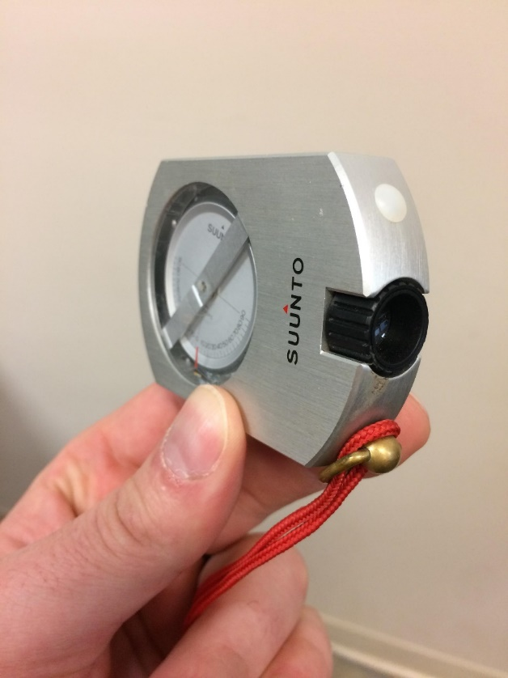
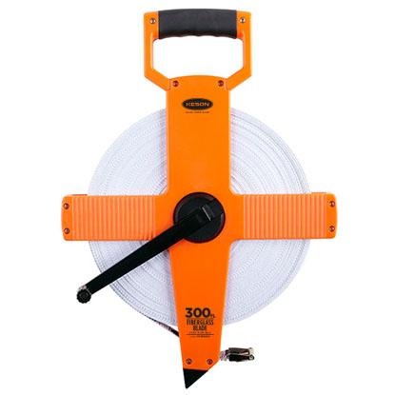
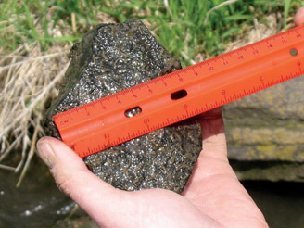
Methods – Site Characterization
Elevation (m)
Aspect (º)
Slope (%)
Bank Full (m)
Pebble Median (mm)
Google Earth
Compass
Clinometer
Tape Measure
Wolman Pebble Count

Slide 8
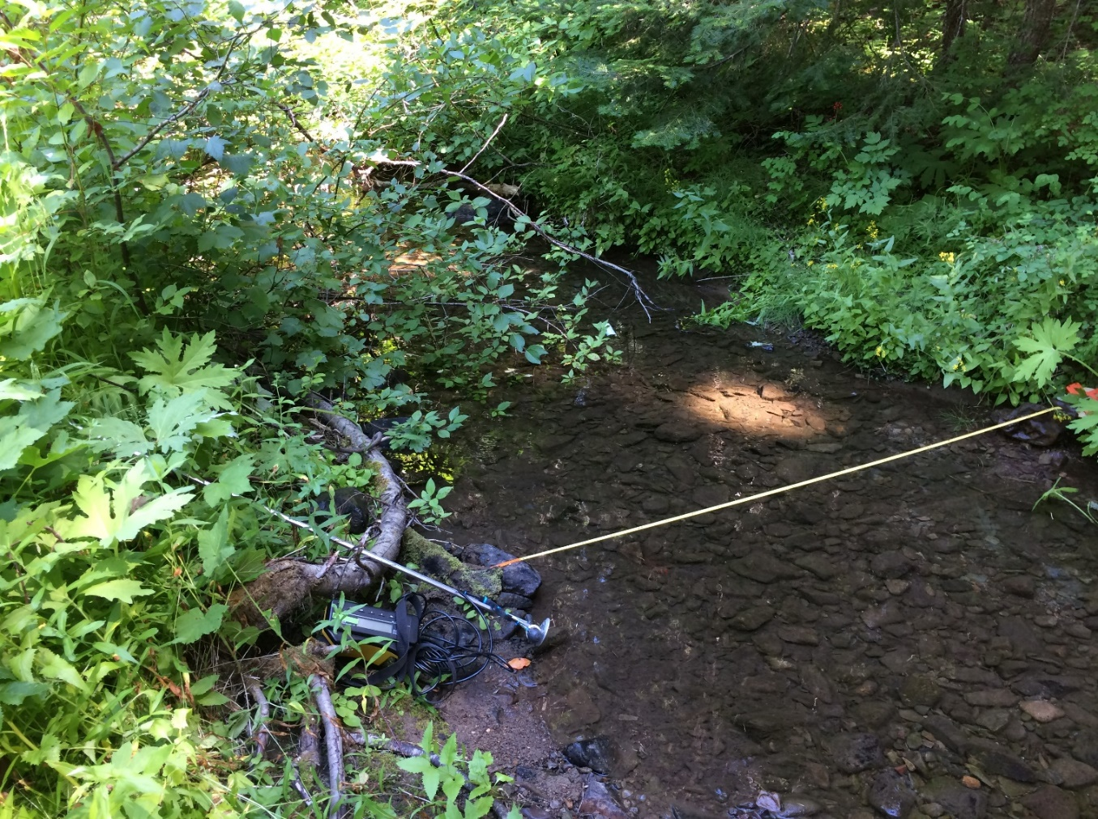
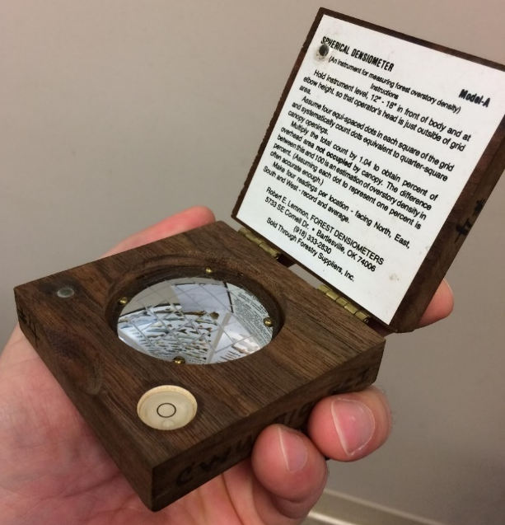
Methods – Seasonal Variables
Wetted Width (m)
Depth (m)
Discharge (L/s)
Canopy (% open)
Flow Meter and Tape
Densiometer

Slide 9
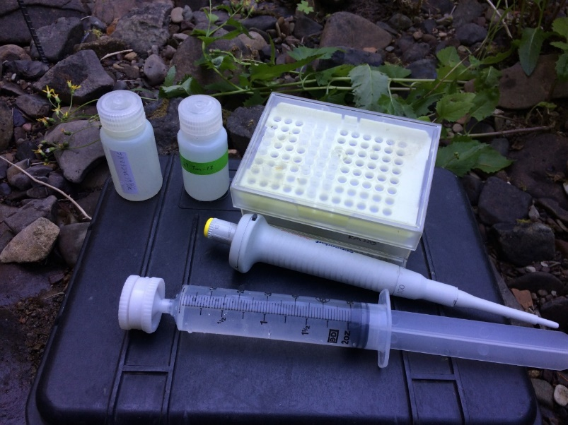
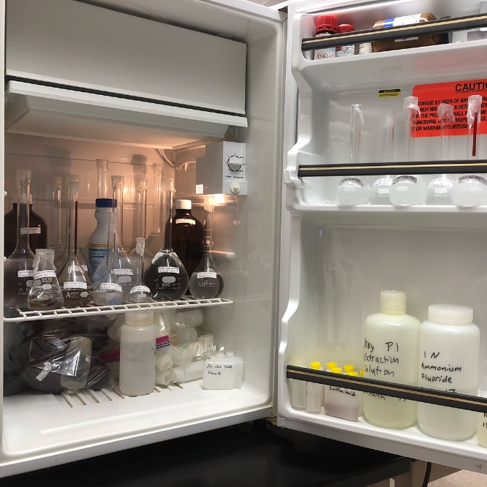
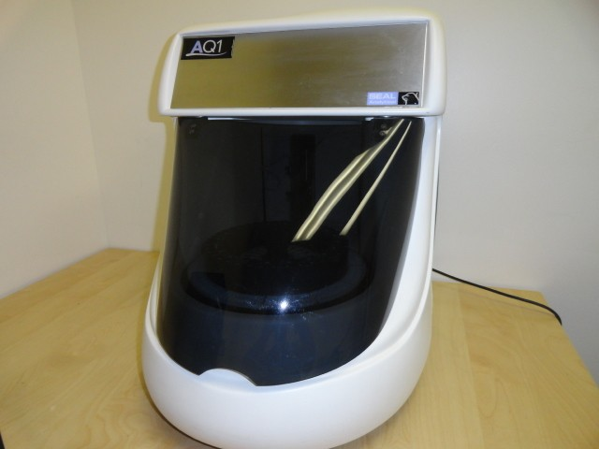
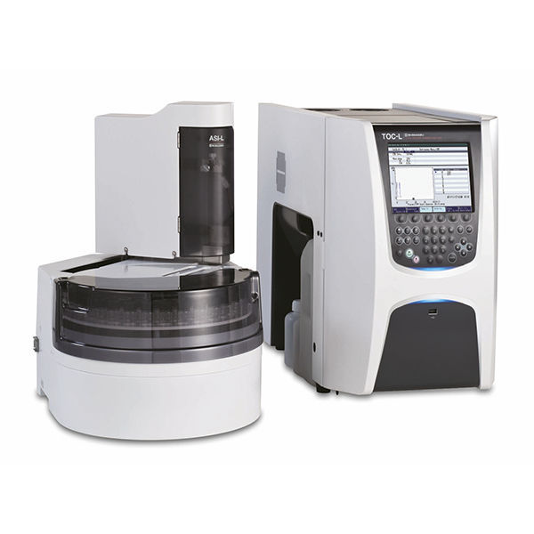
Methods – Seasonal Variables
Ammonium (mg N/L)
Nitrate (mg N/L)
Phosphate (mg P/L)
Dossolved Organic Carbon (mg C/L)
Ammonium and Nitrate were at or below detection limits.
Water samples filtered and frozen.
TOC-L Total Organic Carbon Analyzer
Reagents
AQ1 Discrete Analyzer

Slide 10
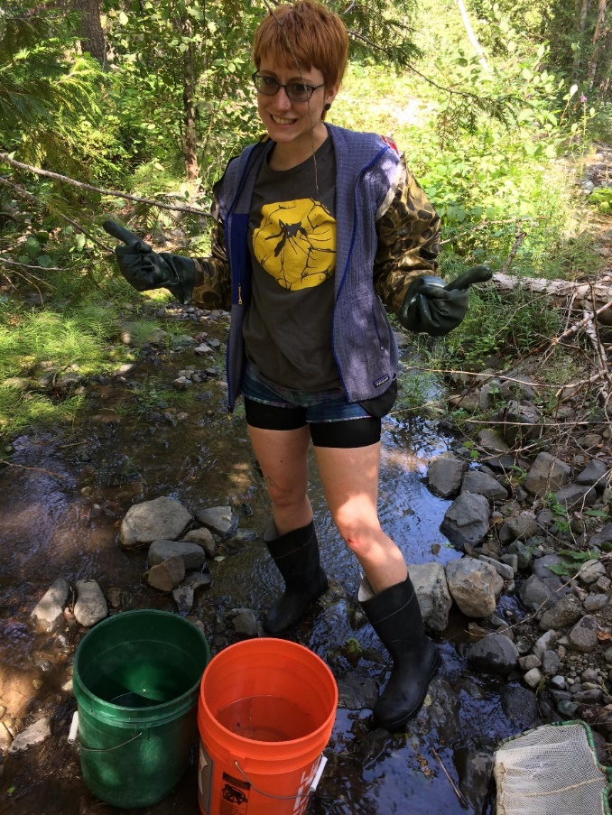
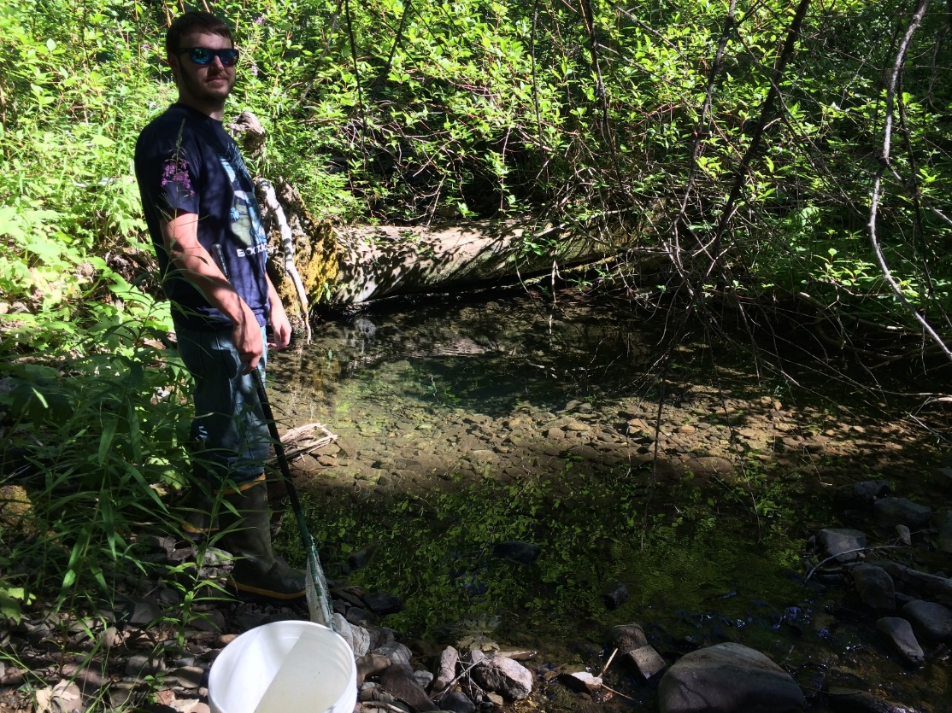
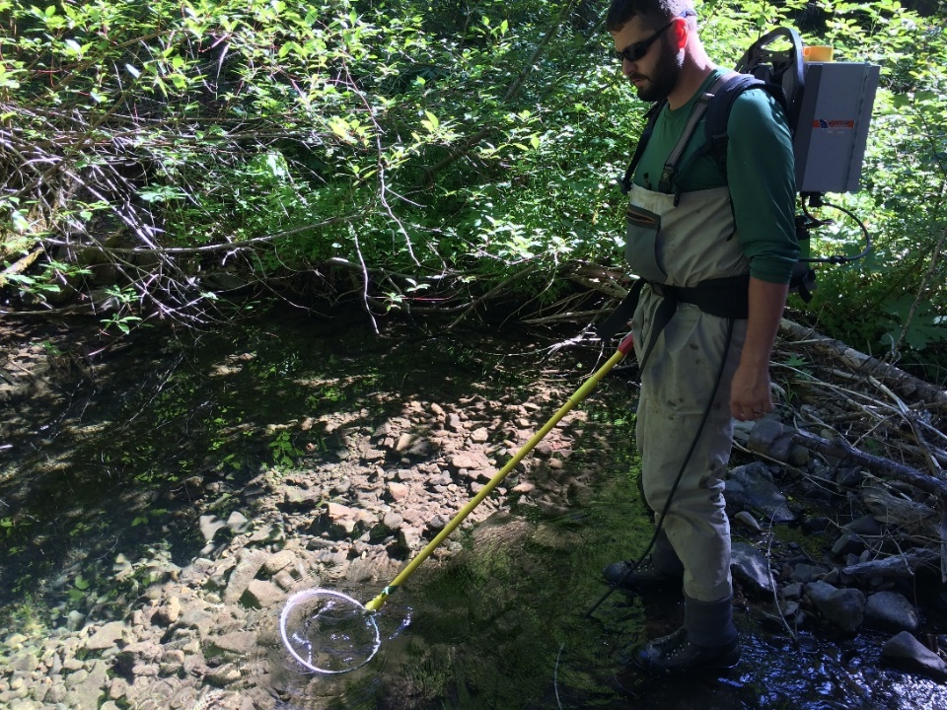
Methods – Seasonal Variables
Cutthroat Biomass (g/m of stream)
(Oncorhynchus clarki lewisi)
Kayla Gallentine
Adam Hess
Electrofisher for 2 pass depletion estimate of trout population

Slide 11
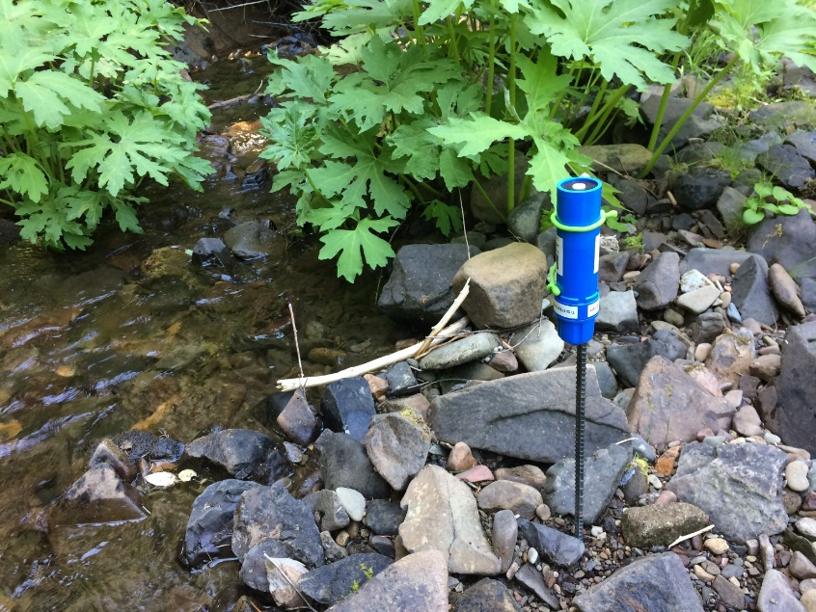
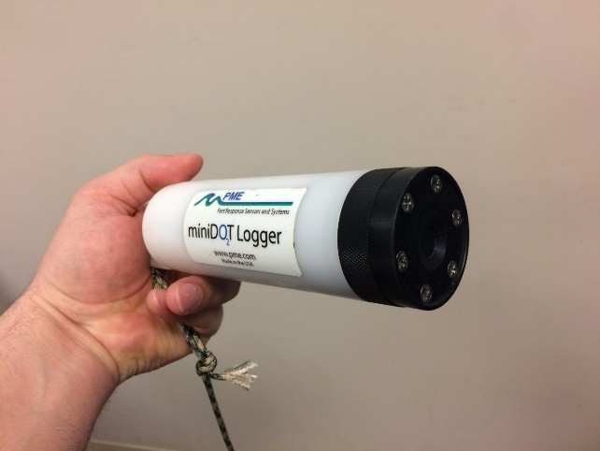

Methods – Seasonal Variables
Photosynthetically Active Radiation (PAR) (µmol/m²/s)
Water Temperature (ºC)
Dissolved Oxygen (DO) (mg/L)
Gross Primary Production (GPP) (g O₂/m²/d)
Ecosystem Respiration (ER) (g O₂/m²/d)
Photosynthetically Active Radiation (PAR) meter
Dissolved Oxygen and Temperature logger
One Station Metabolism Inverse Modeling

Slide 12
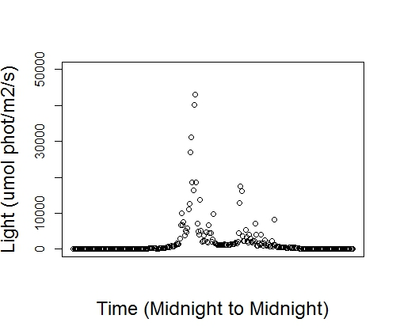

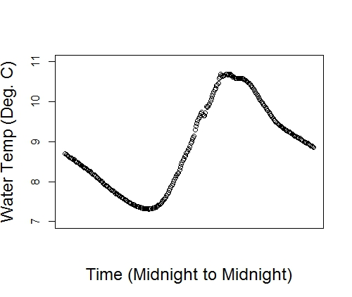

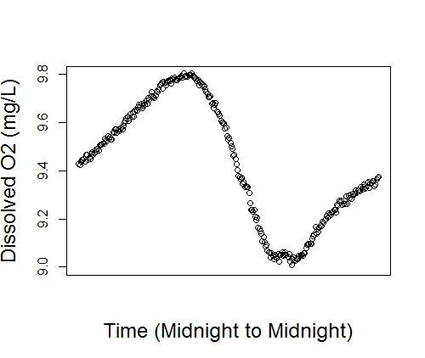
Inputs:
Syncronized logging every 5 minutes
+Depth
+Barometric Pressure

Slide 13
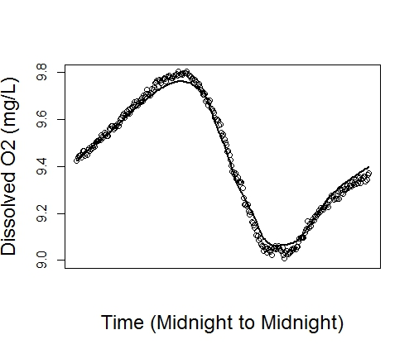
Methods – Seasonal Variables
Not good for headwater streams.
Outputs
Estimates of:
GPP (autotrophic)
ER (auto + heterotrophic)
Gas Exchange Constant (k600)
Negative Log Likelihood
Model fit graph

Slide 14
Methods – Seasonal Variables
GPP model issues
Was the model fit good?
Was GPP positive?
Was ER negative?
Was the k600 within reasonable limits?
When model output was not believable a different k600 was substituted in the model.
This value came from the same stream in a different sampling or the most similar other stream.
13 of 30 were changed, 4 left out entirely

Slide 15
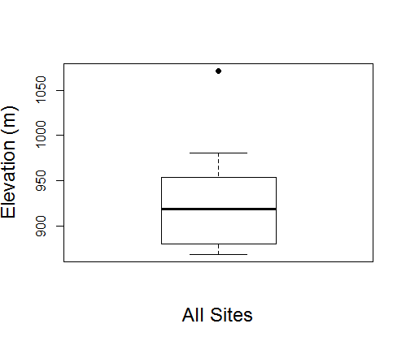
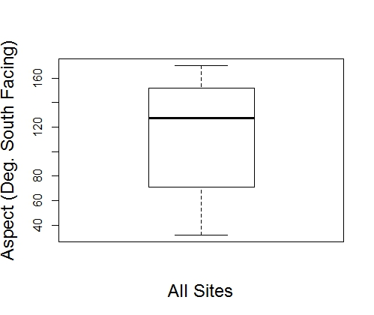
Site variables
North South

Slide 16
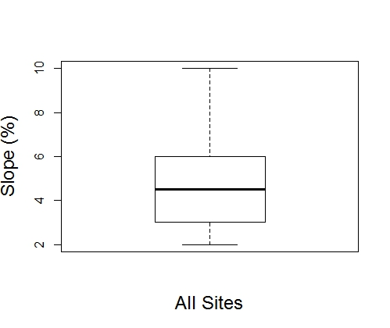
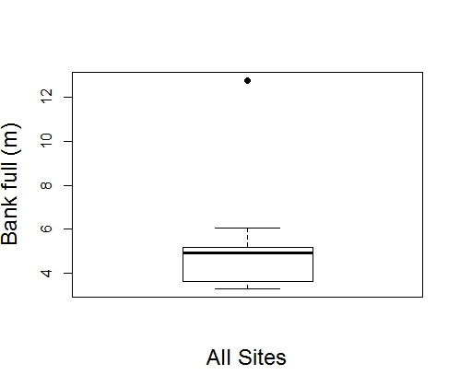
Site variables

Slide 17
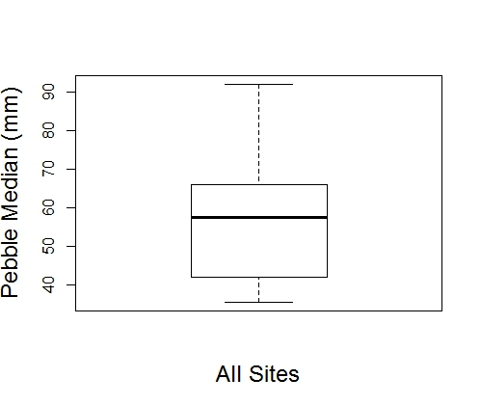
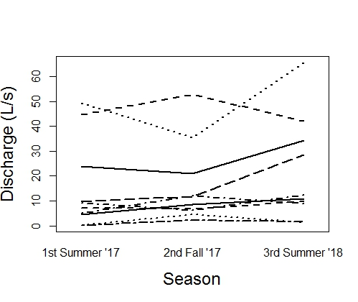
Site variables
A
A
A

Slide 18
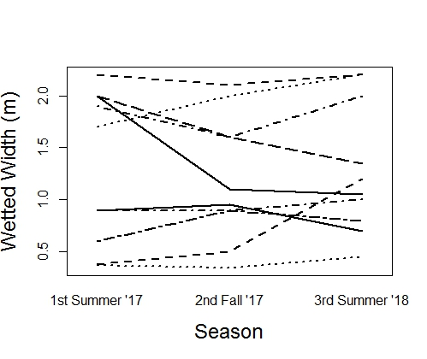
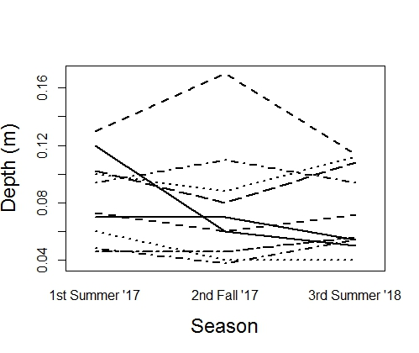
Results
A
A
A
A
A
A

Slide 19
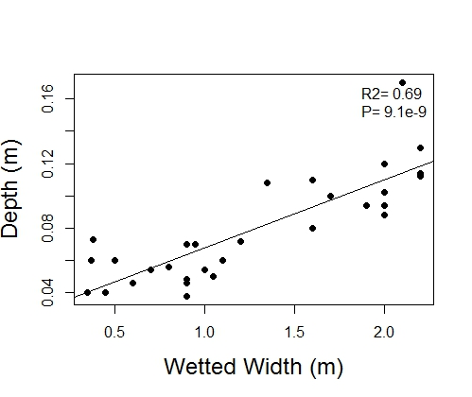
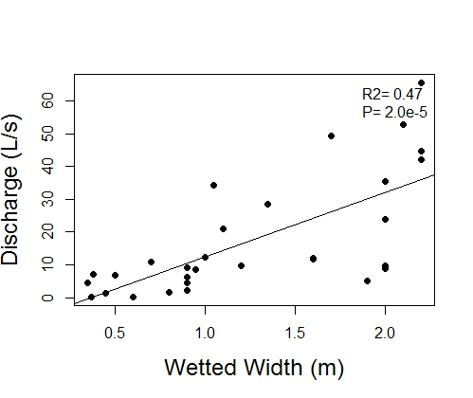
Results

Slide 20
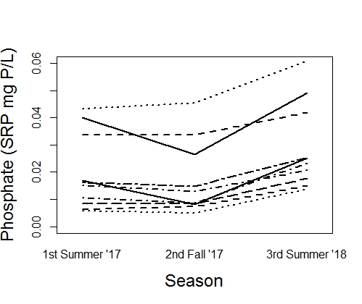
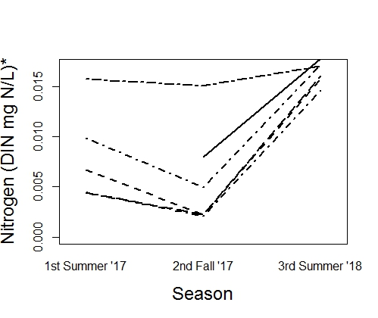
Results
B
B
A
B
B
A

Slide 21
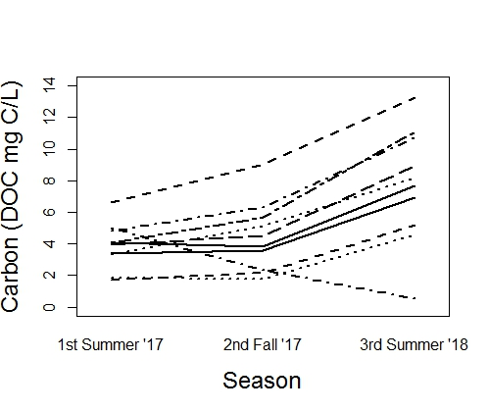
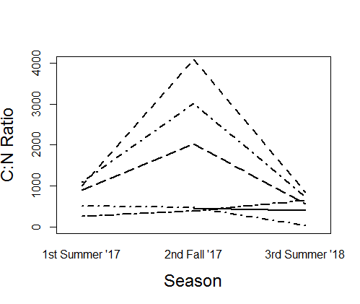
Results
Typically below 5 mg/L for headwater streams
B
B
A
B
A
B

Slide 22
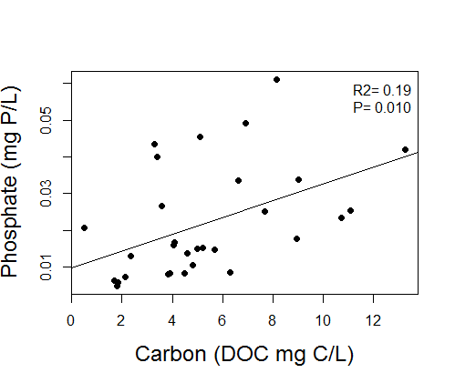
Results

Slide 23
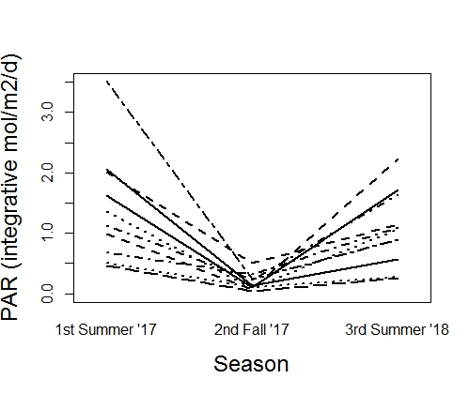
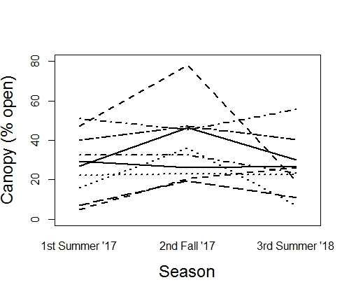
Results
Strong light limitation below 2 mol/m²/d
A
B
A
A
A
A

Slide 24
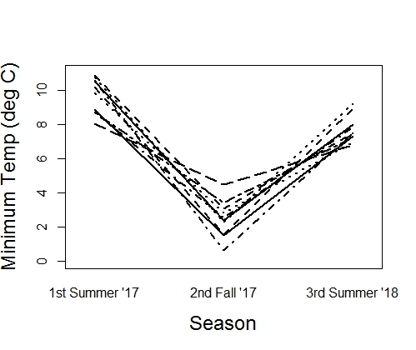
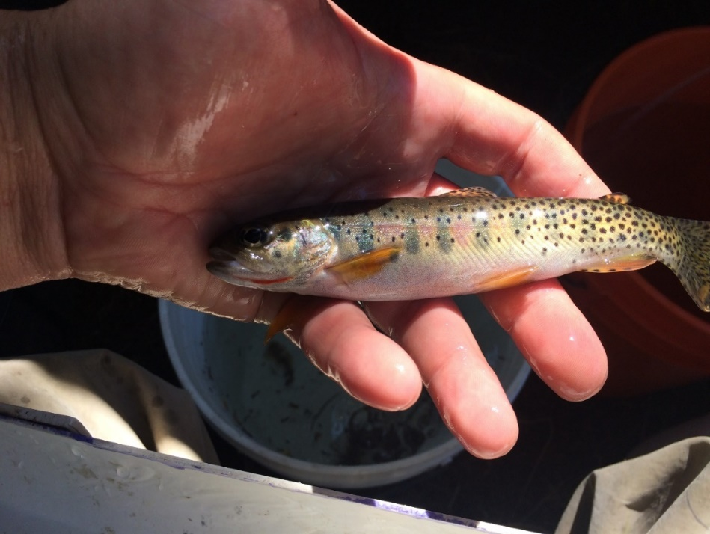
Results
A
C
B

Slide 25
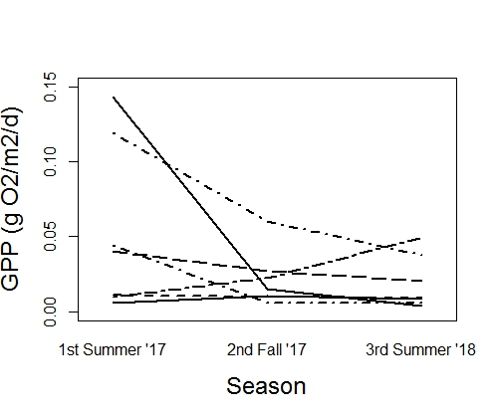
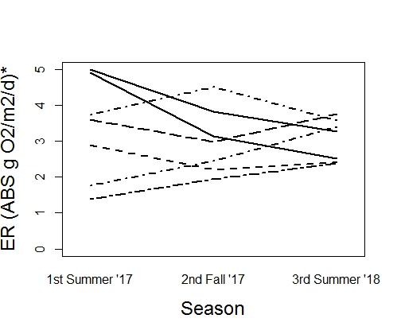
Results
GPP and ER scales much different here
A
A
A
AB
A
B

Slide 26
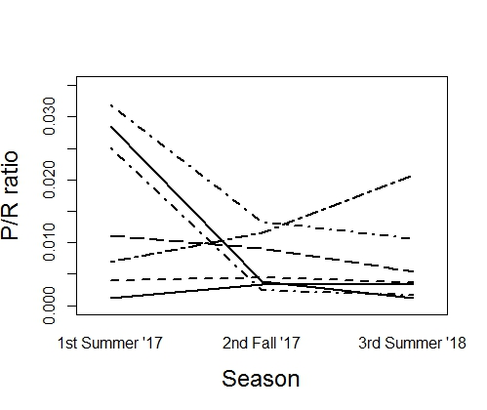
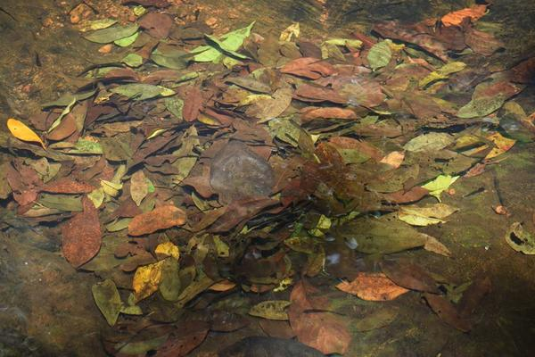
Results
Values below “1” indicate heterotrophic streams
A
A
A

Slide 27
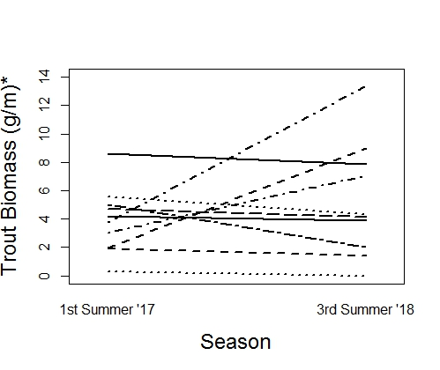
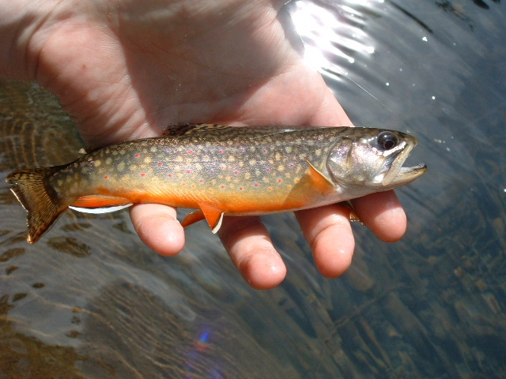
Results
A
A
Some brook trout were found in Jack Cr. ‘18 and included in the biomass estimate (Salvelinus fontinalis)

Slide 28
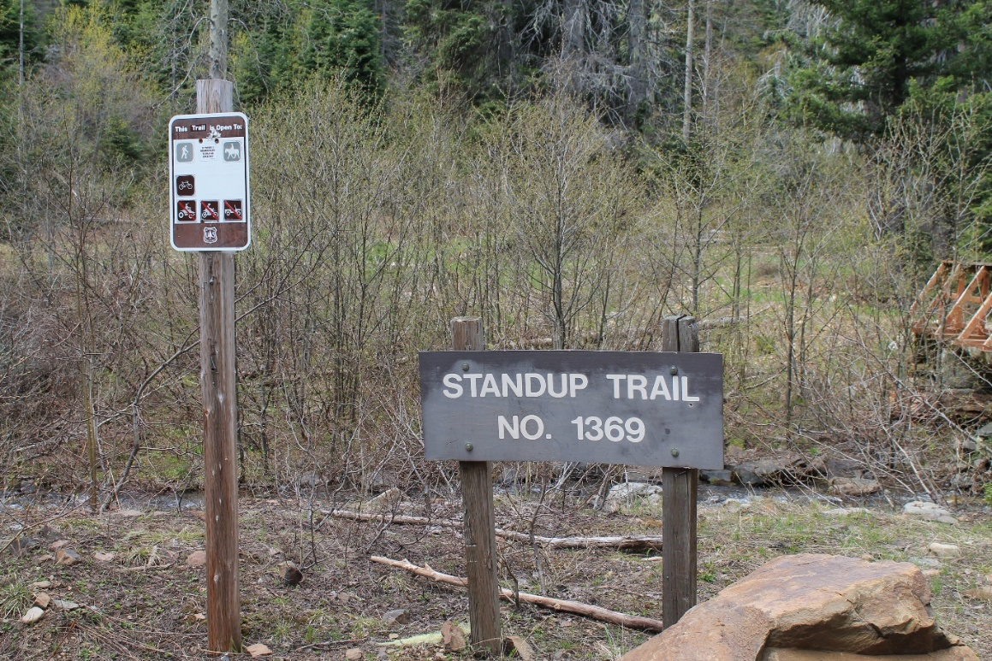
Modeling
GPP, ER and trout biomass model selection:
Evaluate responses for normality, transform as necessary.
Start with a model with many variables
Drop and add variables according R’s ANOVA P-values, “drop 1” and “step” AIC values for model optimization.
Mixed Effects Models and Extensions in Ecology with R (Statistics for Biology and Health) 2009

Slide 29


GPP modeling
lm(Transformed GPP ~ Pebble + Aspect)
Residual evaluation for model assumptions of no pattern and even spread

Slide 30


GPP modeling
lm(Transformed GPP ~ Pebble + Aspect)
R²= 0.28 P= 0.0090

Slide 31


ER modeling
lm(Transformed ER ~ Depth + Aspect)
Residual evaluation for model assumptions of no pattern and even spread

Slide 32


ER modeling
lm (Transformed ER ~ Depth + Aspect)
R²= 0.61 P= 6.8e-6
“Depth” is in ER estimation model however it is likely related to the reaeration coefficient

Slide 33


Cutthroat biomass modeling
lm (Transformed CUT biomass ~ Wetted Width + Minimum Temperature)
Residual evaluation for model assumptions of no pattern and even spread

Slide 34


Cutthroat biomass modeling
lm (Transformed CUT biomass ~ Wetted Width + Minimum Temperature)
R²= 0.35 P= 0.010

Slide 35
The take away so far…
GPP and ER are higher in streams on south facing slopes.
More trout biomass is associated with lower minimum temperatures.

Slide 36

Questions?

Slide 37


Additional explored relationships

Slide 38


Additional explored relationships

Slide 39


Additional explored relationships

Slide 40


Additional explored relationships

Slide 41


Additional explored relationships

Slide 42


Additional explored relationships

